Slide 1
Square pegs in round holes
Paul Raff
Principal Data Scientist Lead, Microsoft
02/04/2016

Slide 2
Welcome!
In the first 5 minutes, get prepared:
Go to http://www.myraff.com and check out the blog post, which has links to the gitlab repository with this deck and the sample/starter code we’ll be going through.
I’ll be working in R, but you can work in whatever language is good for you.

Slide 3




About Me
 | 2004 – BS Mathematics, BS Computer Science
 | 2009 – PhD Mathematics
 | 2010 – Applied Researcher, Supply Chain Research
 | 2012 – Principal Data Scientist, Analysis and Experimentation

Slide 4


Icebreaker:
OneNote Welcome Email

Slide 5

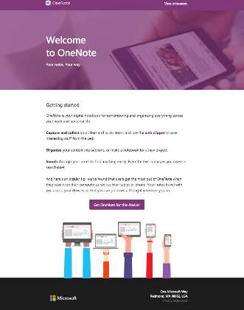
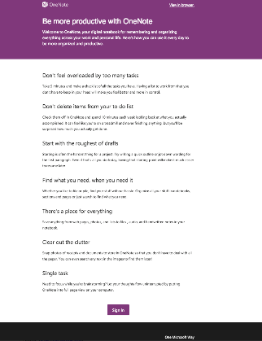
Welcome Email
A
Getting Started
B
Usage Tips
Which variant has more actions per user?
Raise your left hand if you think A Wins (left, “getting started”)
Raise your right hand if you think B Wins (right, “usage tips”)
Don’t raise your hand if they are the about the same
Notes:
<<NEXT>> Example 2 Results

Slide 6
Welcome Email
B
Usage Tips
WINNER IS
B
Which variant has more actions per user?
Raise your left hand if you think A Wins (left, “getting started”)
Raise your right hand if you think B Wins (right, “usage tips”)
Don’t raise your hand if they are the about the same
Notes:
<<NEXT>> Example 2 Results

Slide 7
Three Situations
Dealing with data in an API world
Doing analysis on data in an API world
Dealing with data applications requiring data in a certain format

Slide 8
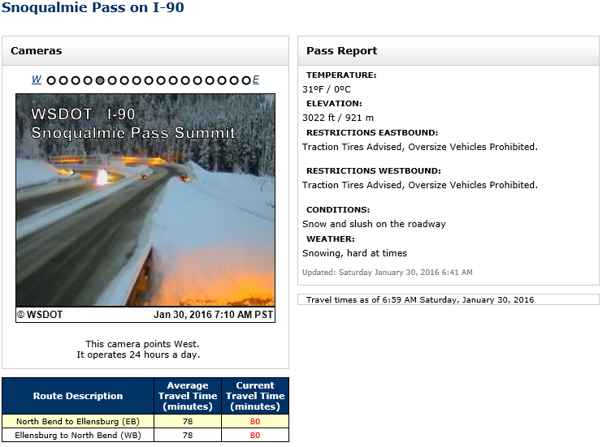
Example: WSDOT Mountain Conditions
WSDOT provides periodic updates on 15 mountain passes.

Slide 9
Example: WSDOT Mountain Conditions
API-driven, publicly-accessible API.
You can try it out, too: http://bit.ly/wsdot-api-call

Slide 10
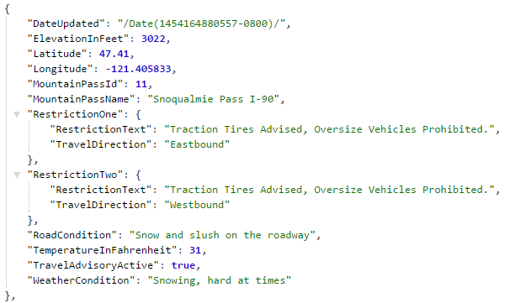
Example: WSDOT Mountain Conditions

Slide 11
Example: WSDOT Mountain Conditions

Slide 12
Things To Think About
This is all well and good for WA.
If we wanted to build an application or better understand the situation in other states, how do you do so?
States will create their data in the way they see fit.
More on this in a bit.

Slide 13
Lesson 1 – Data Standards
WSDOT gives back the data in one of two forms:
JSON – JavaScript Object Notation
XML – eXtensible Markup Language
Each application has its own way of dealing with data:
R – Data Frames
Python – Pandas
C# - DataTables
…
Data standards allow for efficient communication between applications, regardless of implementation details.

Slide 14




Lesson 1 – Data Standards
Without data standards, any application wanting to deal with data would have to worry about how to input/output to all other applications.

Slide 15
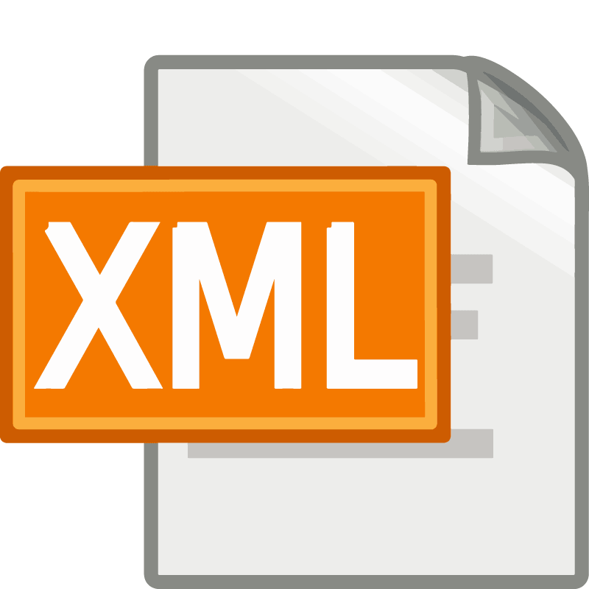

Lesson 1 – Data Standards
With data standards, application developers only need to worry about input/output to one of the standard formats.
Standards become efficient intermediaries between applications.

Slide 16
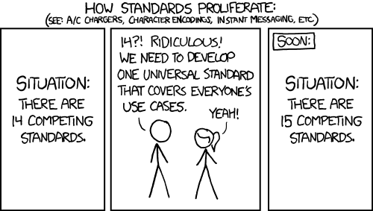
Obligatory Comic Relief
We should be fortunate there’s not much else besides JSON and XML.
http://xkcd.com/927/

Slide 17
The Square Peg and the Round Hole
Their data format
Your desired
data format

Slide 18
The Square Peg and the Round Hole
Their data format
Your desired
data format

Slide 19
Exercise 1 – WSDOT -> R
If you use R, (hopefully) you like having your data in a data frame format.
However, WSDOT gives you data in JSON.
Get the data in JSON.
Convert the data to a data frame.
Think: once we’re in a data frame, are we immediately ready to go?

Slide 20
Example 1 – WSDOT -> R
Leverage already-existing libraries
rcurl
jsonlite.
See wsdot-data-exercise-1.R in the gitlab repository

Slide 21
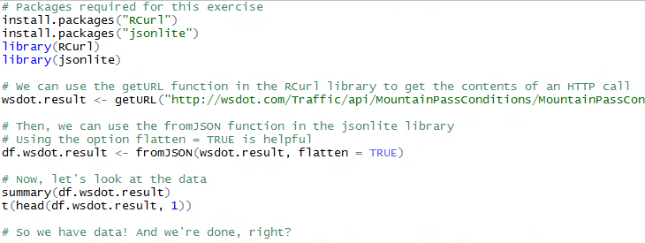
Example 1 – WSDOT -> R

Slide 22
But – how to analyze?
APIs are application-driven: data provided when requested.
However, analysis-driven scenarios require more complete data:
Ideally, information every time something changed.
Analysis-driven scenarios improve the application:
Knowledge of additional information of value, e.g. this pass was closed 6 out of the last 30 years on this day.
Ability to model the scenario for predictive purposes

Slide 23
How To Resolve?
Ideally: call up WSDOT, ask for the data, and get it.

Slide 24
How To Resolve?
Ideally: call up WSDOT, ask for the data, and get it.
Realistically: you can’t assume you have any access to the data providers.
You get what you get.

Slide 25
Thoughts?
How do we get data?

Slide 26
The Square Peg and the Round Hole
API-Based Data Services
Data
Analysis

Slide 27
The Square Peg and the Round Hole
API polling
API-Based Data Services
Data
Analysis

Slide 28
Lesson 2 – Polling
Put simply, polling is the repeated access of a bit of data, which presumably changes periodically.
Set a time interval, and repeat the process.
Pseudocode:
dataset <- {}
while(true)
result <- call API
append result to dataset
sleep X minutes

Slide 29
Lesson 2 – Polling Considerations
First and foremost, you have to realize now that you are writing code more than doing data analysis.
If you’re collecting data continuously, how do you ensure that there’s no missing data? What do you do if there’s a problem?
Discuss: what potential problems could there be?

Slide 30
Exercise 2 - Polling
Building on your code from exercise 1, set up some code that will poll every minute for a day.

Slide 31
Exercise 2 - Polling
Building on your code from exercise 1, set up some code that will poll every minute for a day.
See you tomorrow! (Kidding)

Slide 32
Exercise 2 - Polling
Building on your code from exercise 1, set up some code that will poll every minute for a day.
Or, you can get the data from the gitlab repository.
Load the file wsdot-data.Rdata into your R session
Anything interesting about the data?

Slide 33
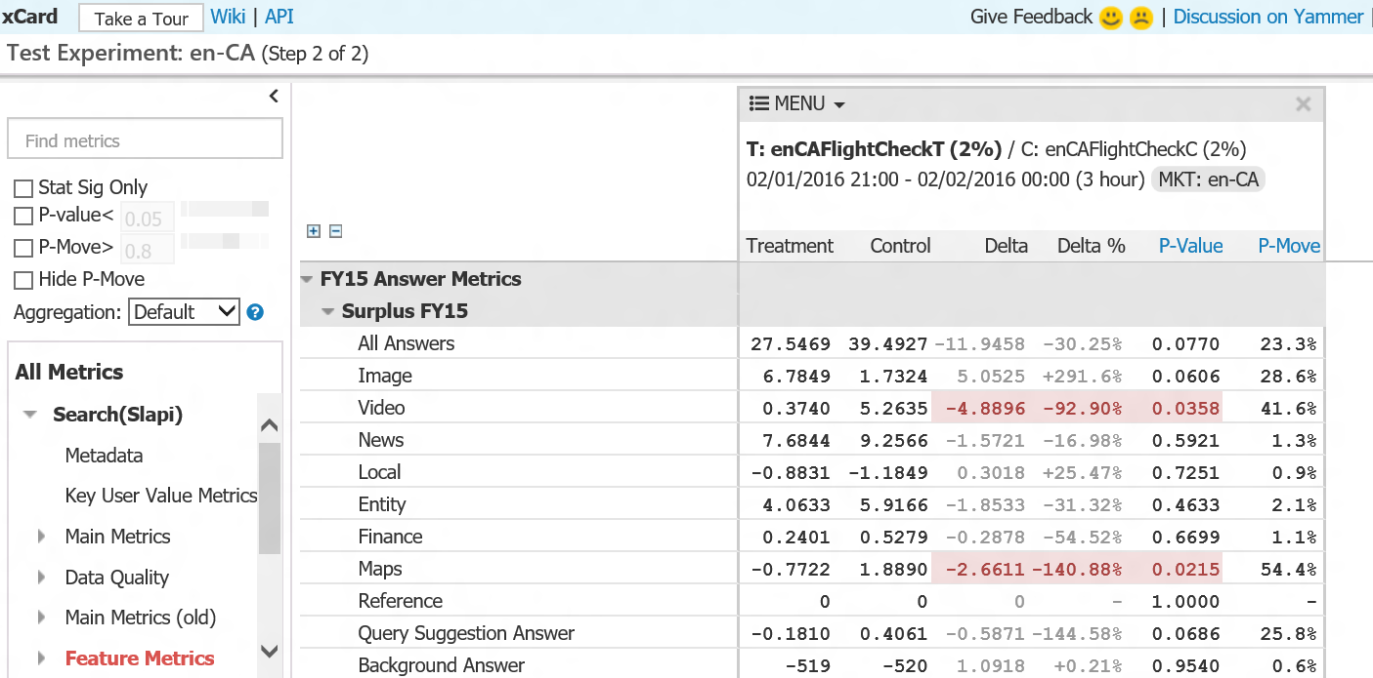
Great – you have data. Now what?
In ExP, our primary analysis product is the so-called A/B experiment scorecard, which takes in data and outputs a great summary of the results of your experiment.

Slide 34
Great – you have data. Now what?
Data is required to be in a specific format with specific column names. Otherwise, you get nothing.
Required columns:
USER_ID (represents the user)
TREATMENT (represents the treatment)
REQUEST_TIME
. . . and others

Slide 35
Great – you have data. Now what?
This worked great for Bing, where we first started doing massive experimentation.
Bing’s data is stored in effectively a single huge table – 200TB/day!
For other partners we work with, there was no such Big Fat Table that held all of the data.

Slide 36
Great – you have data. Now what?
For example, Office may have data structured in this way:
Action-level data: each row in this table represents an action that was performed
Error data: data related to errors that occurred.
Performance data: data related to load times/latencies/etc

Slide 37
The Square Peg and the Round Hole
The data as you have it
The data as you
want it

Slide 38
The Square Peg and the Round Hole
Views
Data pipelines
The data as you have it
The data as you
want it

Slide 39
Lesson 3: Views and Data Pipelines
A view is a virtual representation of the data.
Querying over the VIEW does the necessary data manipulations dictated dynamically and at time-of-query.

Slide 40
Lesson 3: Views and Data Pipelines
A data pipeline is a physical transformation from one data format to another.
Data pipelines can cross boundaries between different data serializations.
Final

Slide 41
Views or Pipelines?
They both exist for a reason.
Primary pros for views: no extra data necessary for storage, handles changes in the underlying data sources trivially.
Primary pro for data pipelines: processing is only done once.
In big data applications, pipelines are preferred to views for two reasons:
Data storage is relatively cheap compared to computational resources
Most data is write-once and rarely updated

Slide 42
Data Pipelines in MSFT: Avocado
Internally, we utilize a nifty web application – Avocado – that allows us to easily and transparently set up and monitor data pipelines for our needs.
Data in MSFT exists in various forms: SQL databases, COSMOS (proprietary big data platform, similar to Data Lake), plain files, Spark clusters, etc.

Slide 43
Data Pipelines in MSFT: Avocado
Exactly like earlier in the workshop, Avocado allows us to not worry about connections between each pair of data sources.

Slide 44

Data Pipelines in MSFT: Avocado
Avocado is the intermediary between the data, providing so-called bridges between itself and any other data format that exists.
To build a data pipeline, you build the bridges and define their structure.

Slide 45
Exercise 3 – Building a Data Pipeline
Grab the exercise 3 Rdata file from the gitlab repository
It contains three different data frames:
df.actions
df.userdata
df.flightinfo
We want to combine this data into one frame that has, at the least, the following three fields: USER_ID, TREATMENT, DATE.
Also want to add a SEGMENT_UserAge field to understand our measurements sliced by user age.

Slide 46
Exercise 3 – Building a Data Pipeline
df.actions
Join by user
Join by user
df.userdata
Final
df.flightinfo

Slide 47
Exercise 3 – Building a Data Pipeline
What assumptions are you making when you are building this pipeline?
How do these assumptions affect your output?

Slide 48
Final Thoughts
DRY – Don’t Repeat Yourself – utilize libraries where available
Various parallels to computer science:
Square peg -> round hole is another way to talk about the adapter design pattern
Polling is a fundamental software development technique
Code is data; data is code
Don’t make assumptions on your data; make assertions on your data
Work backwards:
Think about your solution
Think about what data you need to get for your solution
Think about how you would get that data

